Slide 1




















eFRESH- Computer Vision and IoT Based Framework for Fruit Freshness Detection
Akshata Gawas Krishita Tolia
18104039
18104021
Siddhesh Gaikwad 18104069
Guided by
Prof. Kiran Deshpande Prof. Kaushiki Upadhyaya Co Guide
Prof. Sonal Jain

Slide 2
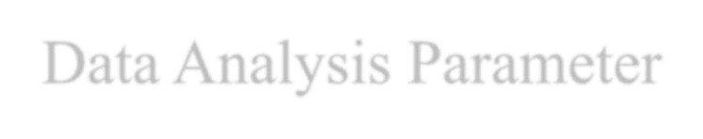


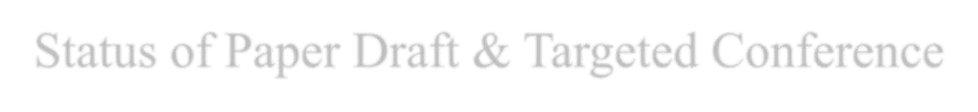
Contents
Introduction
Objectives
Scope
Technology Stack
Data Analysis Parameter
Architecture
Demonstration Model
CNN
InceptionV3
Sensor
Implementation Status
Status of Paper Draft & Targeted Conference

Slide 3

1. Introduction
Problem Identified :
Detection of defected fruits and the classification of fresh and rotten fruits represent one of the major challenges in the agricultural fields. Rotten fruits may cause damage to the other fresh fruits if not classified properly. Traditionally this classification is done by men, which was labour-intensive, time taking, and not efficient procedure. Thus, factories need human intervention for segregation of fruits
Solution Proposed :
Hence, we need an automated system which can reduce the efforts of humans and time of production. Our system will automatically do that with help of CNN classification Algorithm. The proposed idea will create a segregation model which would need no human intervention for classifying and segregating fruits.

Slide 4

2. Objectives
To create a model to classify fresh and rotten fruits.
To pre-process images before sending them to the model.
To achieve efficient model considering the cost.
To train a model with high accuracy.
To develop a hardware system considering the Industry 4.0 standards.
To program NodeMCU for collecting and sending images to server.
To program NodeMCU for segregation.
To host data analysis dashboard on AWS cloud

Slide 5

3. Scope
Can be applied in domestic use.
Can be useful in food industry .

Slide 6

4. Technology Stack
Hardware Requirements:
NodeMCU ESP8266
OV7670 Camera Module
Motor/ Rotator(for conveyor belt)
Wi-Fi module
Flaps
Servo-motor
Alcohol Sensor(MQ3), Methane Sensor(MQ4) Software Requirements:
Google Colab
Tensorflow, Keras, Pandas, Numpy, Matplotlib.
AWS Cloud.

Slide 7
5. Data Analysis Parameter
Color
Shape
Size
Ethanol emission
Methane emission

Slide 8

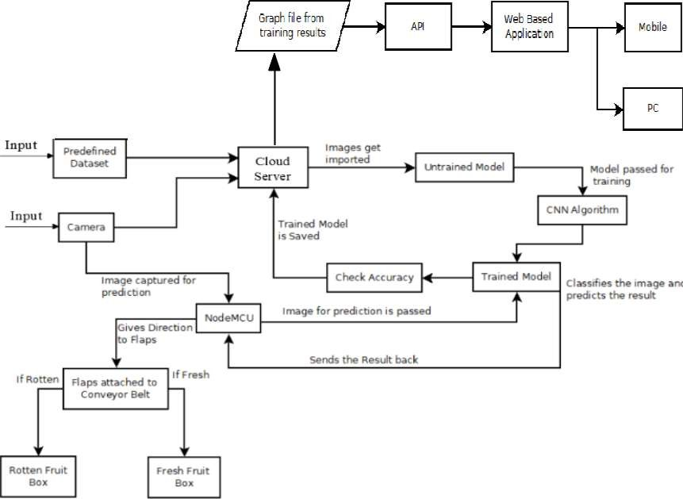
6. Architecture
Figure no.1: Architecture of proposed model

Slide 9
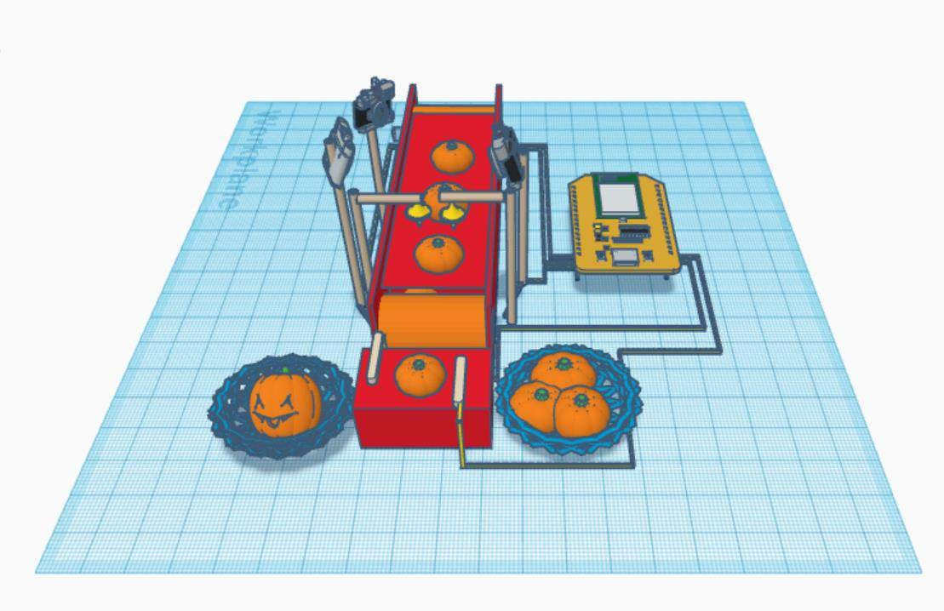
7. Demonstration Model
Figure no.2: Demonstration Model

Slide 10
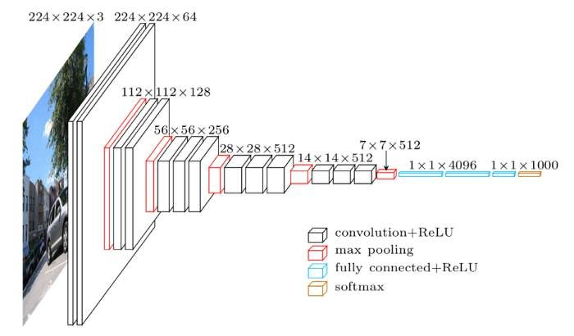
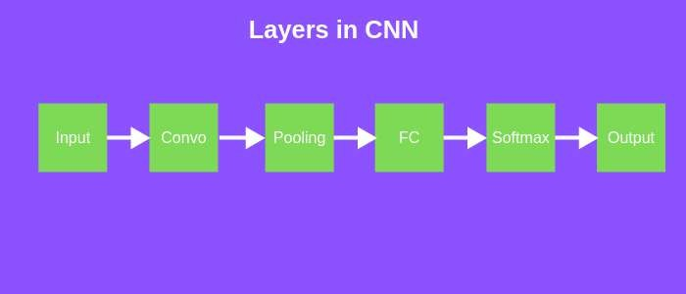
8. Convolutional Neural Network
Figure no.3: Convolutional Neural Network (CNN)

Slide 11

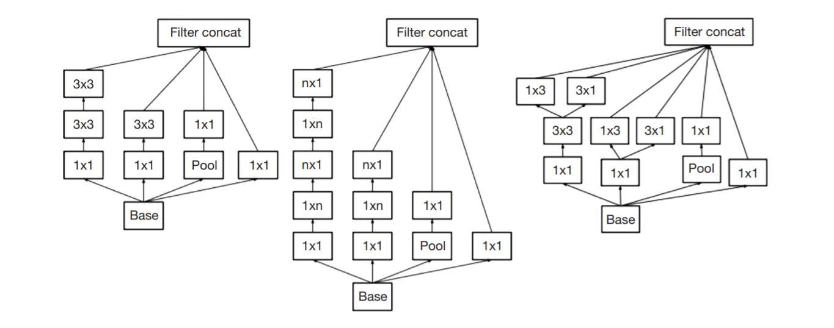
9. Inception V3
Block A
Block B
Block C
Figure no.4: Inception V3 blocks

Slide 12

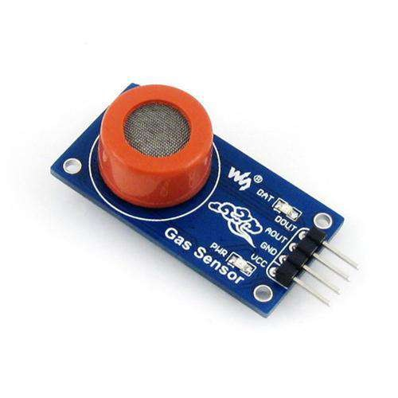
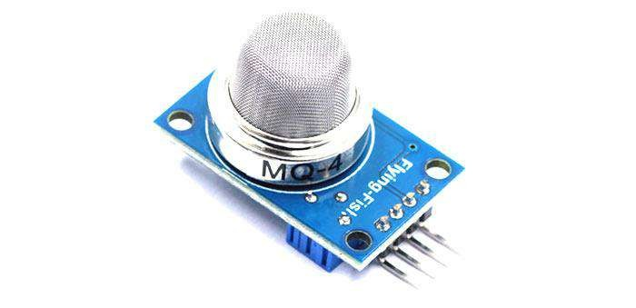
10. Sensors
Figure no.5: MQ4 sensor
Figure no.6: MQ3 sensor

Slide 13
11. Implementation Status
Successfully implemented CNN model with Inception V3 architecture.
Achieved accuracy of 98.5% .
Finalized the architecture required but might need some changes ,since we are in testing phase.
Working on Web Portal

Slide 14

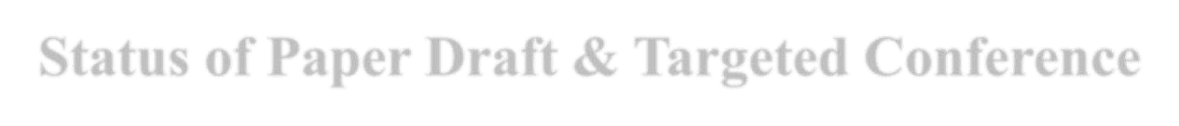
12. Status of Paper Draft & Targeted Conference
Status of paper: Paper writing completed
Conferences:
Submitted at IEEE 2021 Conference on Advances in Computing, Communication and Control - (20th September)
Submitted at CSP-ICE 2021 (4th Information and Computing Education Conference (CSP-ICE 2021)) - (25th September)
Submitted at 2022 7th International Conference for Convergence in Technology (I2CT), Pune, India(15th October, 2021)

Slide 15
Thank You...!!

